Slide 1
Enterprise Architectures
BS42, Lesson 2
Samuil Angelov

Slide 2
Lesson 2
Our approach to enterprise modeling
Organization viewpoint
Product viewpoint
The Archi tool
Work on SMES case

Slide 3
EA Modeling

Slide 4
How do we model an enterprise?
Our choices:
A subset of Archimate
A subset of the standard viewpoints
Simplifications of the standard viewpoints to our course
Why subsets?
We do not need the full Archimate to achieve our goals in this course
We explain per viewpoint its:
Goals
Notation
Example from the BookOnline case

Slide 5
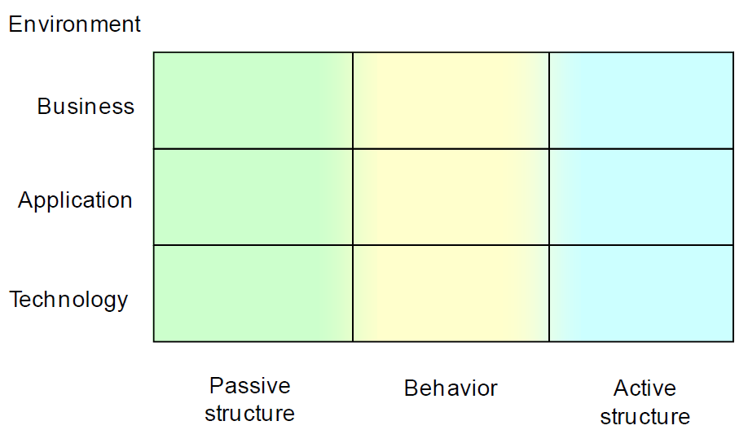
Framework

Slide 6
Standard set of viewpoints in Archimate
Introductory Viewpoint (X)
Organization Viewpoint
Actor Co-operation Viewpoint (X)
Business Function Viewpoint
Business Process Viewpoint
Business Process Co-operation Viewpoint (X)
Product Viewpoint
Application Behavior Viewpoint
Application Co-operation Viewpoint
Application Structure Viewpoint
Application Usage Viewpoint (X)
Infrastructure Viewpoint
Infrastructure Usage Viewpoint (X)
Implementation and Deployment Viewpoint (X)
Information Structure Viewpoint
Service Realization Viewpoint (X)
Layered Viewpoint (X)
Landscape Map Viewpoint (X)
(X) – viewpoint that links multiple layers/aspects

Slide 7
Basic and complex viewpoints
Basic viewpoints model concepts only from one box of the framework.
Semi-complex viewpoints model information from several boxes of one layer the framework.
Complex viewpoints model information from more than one layer of the framework.

Slide 8
Complex viewpoints
Why do we need them?
Views only on one “box” are nicely focused but from them we cannot understand the relation between concepts from different layers.
But if we want to understand how the enterprise works (and IT supporting it) we have to know where data is used (in which process, by whom, in which application), who can use an application, etc.
Thus, we need views that cross among two or more basic and semi-complex views.

Slide 9
Complex viewpoints
We have selected the complex viewpoints which are the most common and illustrate best the need for enterprise architecting and have slightly adapted them.
We start with the basic and semi-complex viewpoints. Then, we look at viewpoints that cross layers.
Examples are based on the PRLG case. However, UML in general does not really support complex views, so the student working on the case had to invent some weird notations to circumvent this.

Slide 10
Basic viewpoints
Basic viewpoints:
Occupy one compartment
Basic viewpoints:
Occupy one compartment
Basic viewpoints:
Occupy one compartment
Viewpoint
Viewpoint
Viewpoint

Slide 11
Semi-complex viewpoints
Basic viewpoints:
Occupy one compartment
Semi-complex viewpoints:
Occupy several compartments from one row
Basic viewpoints:
Occupy one compartment
Viewpoint
Viewpoint
Viewpoint

Slide 12
Complex viewpoints
Basic viewpoints:
Occupy one compartment
Complex viewpoints:
Occupy several compartments from several rows
Basic viewpoints:
Occupy one compartment
Viewpoint
Viewpoint
Viewpoint

Slide 13


(Semi-)Complex viewpoints - why do we need them?
Views only on one “box” are nicely focused but from them we cannot understand the relation between concepts from different layers.
Business processes
(basic viewpoint)
Applications
(basic viewpoint)
Which application is used in which process?

Slide 14
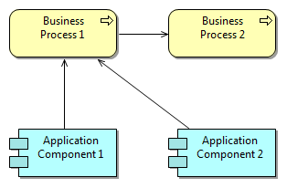
(Semi-)Complex viewpoints - why do we need them?
If we want to understand how the enterprise works (and IT supporting it) we have to know which applications in which processes are used , who can use an application, etc.

Slide 15
Complex viewpoints in this course
We have selected complex viewpoints which illustrate best the need for enterprise architecting.
We start with the basic and semi-complex viewpoints. Then, we look at the complex viewpoints. Why?
Consistency and reuse !

Slide 16
Business processes
(basic viewpoint)
Applications
(basic viewpoint)
A
Define concepts once (in the basic view), use them many times (reuse)
A
Change a concept = change it everywhere where it is used (consistency).

Slide 17
Our set of viewpoints
Basic and semi-complex viewpoints:
1. Organization Viewpoint
Business Function Viewpoint
2. Product Viewpoint
3. Information Structure Viewpoint
4. Business Process Viewpoint
5. Application Structure Viewpoint
6. Application Behavior Viewpoint
7. Application Co-operation Viewpoint
8. Infrastructure Viewpoint

Slide 18
Our set of viewpoints
Complex viewpoints in Archimate:
Introductory Viewpoint
Actor Co-operation Viewpoint
9. Business Process Co-operation Viewpoint
10. Application Usage Viewpoint
Infrastructure Usage Viewpoint
11. Implementation and Deployment Viewpoint
Service Realization Viewpoint
Layered Viewpoint
Landscape Map Viewpoint
Notes:
Introductory Viewpoint – light, general, management/external
Actor Co-operation Viewpoint - management/external
9. Business Process Co-operation Viewpoint
10. Application Usage Viewpoint
Infrastructure Usage Viewpoint – requires knowledge from EA6/EA7
11. Implementation and Deployment Viewpoint – only high-level - addressed in GSO32;
Service Realization Viewpoint
Layered Viewpoint – easily gets overburdened
Landscape Map Viewpoint - vague

Slide 19
Basic viewpoints
Organization viewpoint

Slide 20
Organization Viewpoint
The Organization viewpoint focuses on the (internal) organization of the company (or a department).
Stakeholders: Enterprise, process and domain architects, managers, employees, shareholders.

Slide 21
Positioning the viewpoints
Organization

Slide 22
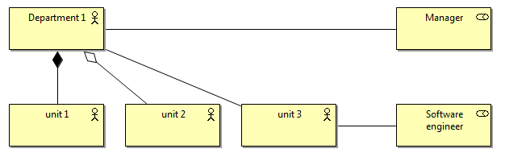
Notation
Concepts and relations (simplified): Business Actors and Business Roles
Business Role:
Behavior, to which an
actor can be assigned
Relations (a la UML) between Business Actors:
Aggregation
Composition
Association
Between Business Roles and BA
- Association
Business Actor: An organizational entity (humans, departments, and business units).

Slide 23
Book Online case example (text)
The Chief Executive Officer of BookOnline is Timothy Ward. He manages four divisions: Business Development, Finance, Digital Media, Customer Service & Operations (CS&O). Because CS&O is a bigger division it has its own Vice President. The CS&O division is split into separate subdivisions for Customer Service and Operations. The Packaging team belongs to the Operations subdivision.

Slide 24
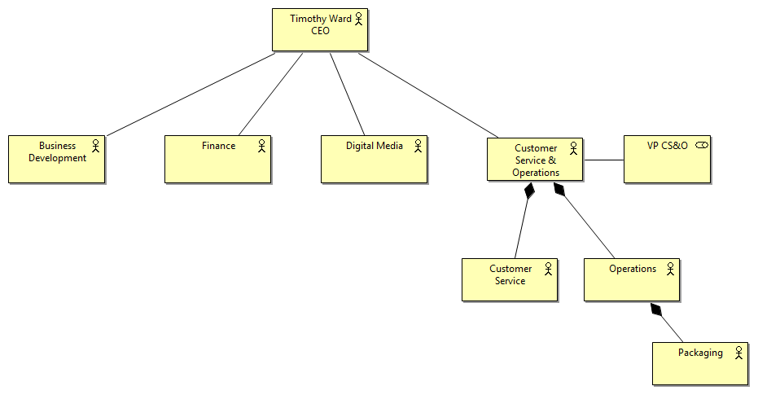
Book Online Case example (model)

Slide 25
Basic viewpoints
Product viewpoint

Slide 26
Product viewpoint
The Product viewpoint depicts the products offered to the customers or other external parties involved and shows the composition of one or more products in terms of the constituting business services.
Stakeholders: Product developers, product managers, process and domain architects

Slide 27
Positioning the viewpoints
Product

Slide 28
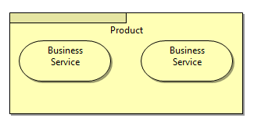
Notation
Concepts and relations (simplified): Products and Services
Product: a coherent collection of services offered to the client as a package
Service: a service that fulfills a business need for a customer (internal or external to the organization)
Relations (a la UML) between Product and Service
Aggregation (in this example it is modelled with “zooming in”)
Specialization (see next slide)

Slide 29
Case example (text)
As the name of the company already hints, BookOnline is selling books through the Internet. Recently they started to also sell E-books, next to the old-fashioned hardcopy books. The shop is used a lot for customers buying birthday gifts for their family or friends, so BookOnline offers a gift service: the hardcopy book is wrapped in a fancy gift paper and sent directly to the birthday person. People can register at book online such that their address information and favorite books are stored for them when they return to the BookOnline shop.

Slide 30
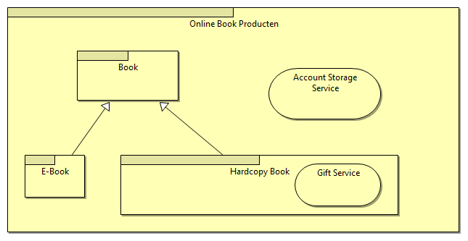
Case example (model)

Slide 31
Assignment

Slide 32
Tools
In general:
UML: modeling: All UML modelling tools
Archimate: Archi, Bizzdesign Architect, Visual Paradigm EE
In this course:
Archi: http://www.archimatetool.com/
Free, simple, light, and easy to use
Download at: http://www.archimatetool.com/download

Slide 33
Work on SMES case
Download the Archi tool. http://archi.cetis.ac.uk/download.html
Study Archi.
Study the SMES case.
Make models for the organization and product viewpoints in Archi.
Check next week with the teacher the correctness of your models.

Slide 34
Work on the case

